Slide 1
VAJRA IoT
PRIVATE LIMITED
Passion | Innovation | Transformation
Email: Info@vajraiot.com
Web: www.vajraiot.com
Cell: +9140-23554595

Slide 2
CONTENT
About Us
Corporate Profile
Key Activities
Business Offerings
Milestones
Differentiators
Our Solutions
Management Team
Clients

Slide 3
ABOUT US
We are an ISO 9001: 2015 and 14001: 2015 certified company, founded by a group of technocrats in 2009.
We work on quick customized solutions using micro controllers /microprocessors and disruptive technologies like System on Chip and system on module . Our solutions use Communication network technologies like 2G/3G/NBIoT/4G as well as RF (Wi-Fi, Bluetooth, NFC and RFID).
Secured User interface to enable the customers to customize, manage usage, events, alerts.
All IT solutions are designed to work on premise and cloud.
We go by modular architecture, there by improving agility and ease of installation.
We offer end to end solutions through comprehensive IT solution using Web App, Mobile App, Dash boards and Data Analytics

Slide 4
Corporate Profile
Our Value
Take Responsibility and be accountable.
Un-compromised Quality.
Embrace Change Positively.
Encourage Creativity, Passion, Fun.
Mission
To become a market leader in IoT based remote monitoring & management solutions in energy , telecom, Power, Utility & Aqua.
IoT CoE
Consulting
Vision
Provide quality Smart remote monitoring solutions for energy, Power, Utility and infrastructure management, which are cost effective, modular and use cutting edge technologies to enable the customers to create a smarter and greener infrastructure and make the earth smile
Strategy
Leveraging acquired knowledge base, skill set, experience with domain, sensor (relevance, accuracy, precision) technologies

Slide 5
Key Activities
IOT Data Analytics
Mobile App development for Android and IoS
In house Design and development (D&D)
Testing with Extensive WHAT IF use cases
Hardware Design and Development
Manufacturing
Firmware Design and development
Integration & Product Testing
Software Design and development

Slide 6
Business Offerings
Energy
Telecom
Healthcare
Aqua
Automotive
Smart Cities
Information Technologies
Green infra management

Slide 7
Our Solutions
Battery Monitoring and Management Solution
Fuel Monitoring Solution
Vehicle Tracking Solution
Smart Building Management Solution
Asset Tracking Solution
Water Management Solution
Energy Meters & Remote Monitoring Solution

Slide 8
Benefits Derived to customers from our products & Solutions
“One stop shop” for end to end solutions using disruptive technologies and methods.
Technology enabled process efficiency improvements
Real Time Alerts on Events, Track and Trace the Assets, Pilferage Detection & Alerts
Improvement of Operational Performance
Improvements in ROI through digital transformation techniques.
Reduction in Maintenance Costs

Slide 9
Differentiators
Specialized In
Hardware design is In-house & TEEM oriented
Firmware is In-house & FoTA upgradeable
IoT data analytics,
Advanced testing tools
Energy audit
Innovate Using
Built in Controller modules
Communication devices & protocols
Wired & Wireless Communication
Blue-tooth, RFID
Sensors.
Domain Expertise
Knowledge & Focus
Energy / Power
Telecom.
Knowledge
Aqua
Mining.

Slide 10
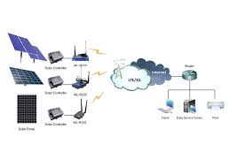
Milestones
2009
Achieved breakeven in less than 12 months from the inception of the company.
2011
End to End remote tower management solution for telecom sector
2012
Applied for patents for wireless battery monitoring system

Slide 11
2015
Diversified into power sector
2017
Launched 3G Modem device, software and mobile app for prepaid metering solution
2019
Launched 4G Automotive and Industrial Modem device, software and mobile app for Tracking and tracing

Slide 12
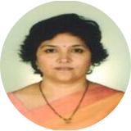
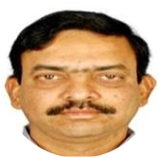
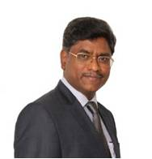
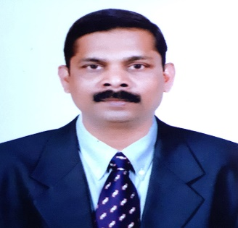
FOUNDER PROMOTERS
FOUNDER PROMOTERS
Mrs. Jhansi is a BEE Certified auditor & EEE Engineer with 20 years of experience in Design and Dev of Power Distribution systems and Remote Monitoring systems.
Mr. M.Vijay Sai is the CEO of S&S Vajra IoT projects and pioneered implementation of Green Building and waste water management concepts
Mrs. G. Jhansi Lakshmi
Mr. M.Vijaya Sai
BOARD OF DIRECTORS
BOARD OF DIRECTORS
Mr. S.Satya Prasad is a Director and CEO of Vajra IoT. He is a Graduate Engineer and a seasoned Technocrat, with 32 years of wide experience in Electronics .He had handled International Business operations involving mergers, acquisitions, take over and migration of Business .
Mr. Vijay is an ECE engineer and is presently the Director of SatCom Technologies Pvt ltd and works on Space & Defence related Projects S
Mr. S.Satya Prasad
Mr. A. S. Vijay Kumar

Slide 13
CLIENTS

